Slide 1



DevOps for Data Science (DataOps)
With Azure DevOps, Docker and Kubernetes
Terry McCann | @SQLShark

Slide 2
“Productionisation of models is the TOUGHEST problem in data science”
Schutt, R & O'Neill C, 2014. Doing Data Science Straight From the Front Line, O'Reilly Press. California
Notes:
Meet a great bunch of people
You’re a point of authority
You get to shout at people
You get in for free (save a bit of money)
Free drinks

Slide 3
But why?
Notes:
Meet a great bunch of people
You’re a point of authority
You get to shout at people
You get in for free (save a bit of money)
Free drinks

Slide 4


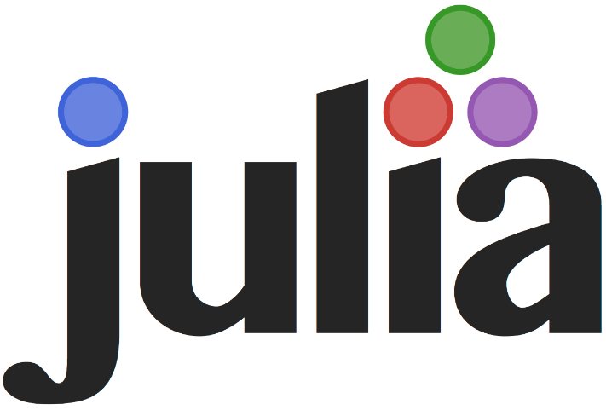

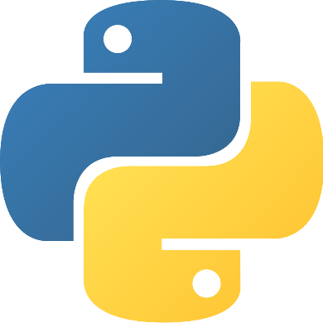
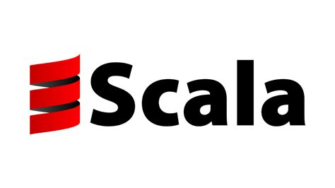


But why?
Notes:
Meet a great bunch of people
You’re a point of authority
You get to shout at people
You get in for free (save a bit of money)
Free drinks

Slide 5
Data Scientist
Highly Academic
Statistically minded
Particularly strong in ML languages
Not from a software background
Thinks testing is hard
Doesn’t use source control
Thinks deployments are the responsibility of another team

Slide 6
Models are not in production
Notes:
Meet a great bunch of people
You’re a point of authority
You get to shout at people
You get in for free (save a bit of money)
Free drinks

Slide 7
How do we fix this problem?
Notes:
Meet a great bunch of people
You’re a point of authority
You get to shout at people
You get in for free (save a bit of money)
Free drinks

Slide 8
Developer
I write code in Python
I write new features
I fix old code & Bugs
I wait weeks to deploy my code
Time to market for my products is suffering
My customers are not happy!
Operations are too slow!

Slide 9
Operations
I manage Production code in Java
Our environments != the same
I am responsible for 99.9% uptime
I manage hundreds of servers
Our company is growing fast and so is my responsibilty
I own the bugs from deployments
Developers don’t care about uptime!

Slide 10

Developer
Operations
CODE

Slide 11
Dev
Ops

Slide 12
1. Culture
2. Source Control
3. Continuous integration/testing
4. Continuous deployment
5. Infrastructure as code
Dev
Ops
6. Configuration as code
7. Automation
8. Operational Monitoring / Feedback

Slide 13
Lets automate the deployment of data science with DevOps
Notes:
Meet a great bunch of people
You’re a point of authority
You get to shout at people
You get in for free (save a bit of money)
Free drinks

Slide 14
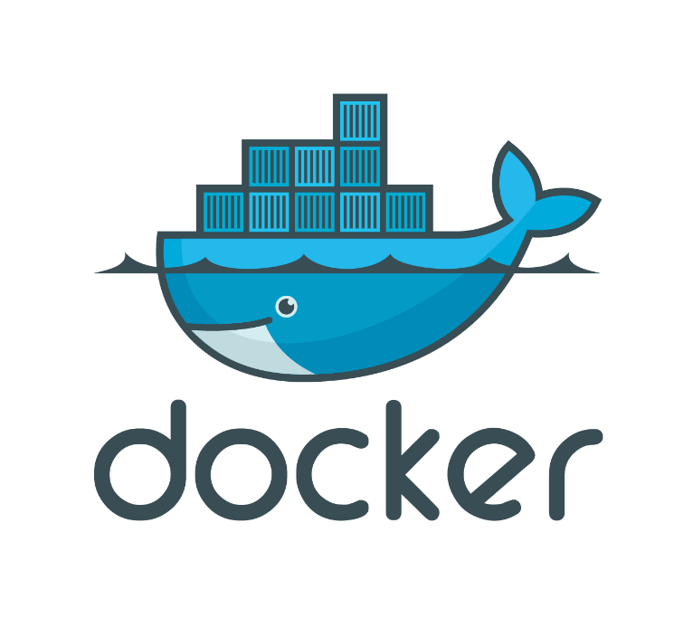
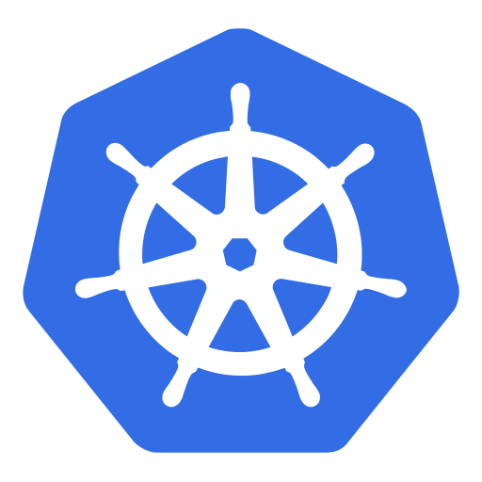

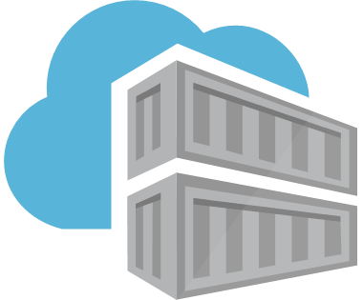
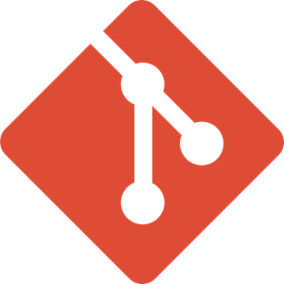
https://modelmanagement.visualstudio.com/DundeeDataScience/
Demo
Notes:
Meet a great bunch of people
You’re a point of authority
You get to shout at people
You get in for free (save a bit of money)
Free drinks

Slide 15
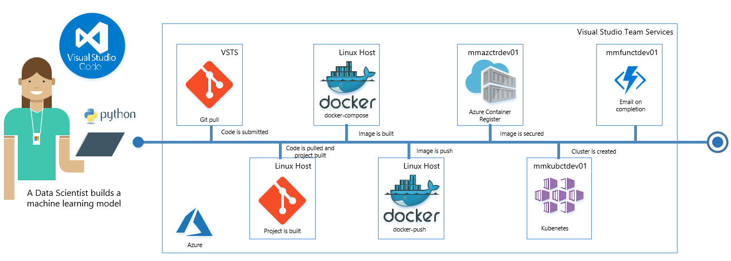
Automate with DevOps
Notes:
Meet a great bunch of people
You’re a point of authority
You get to shout at people
You get in for free (save a bit of money)
Free drinks

Slide 16
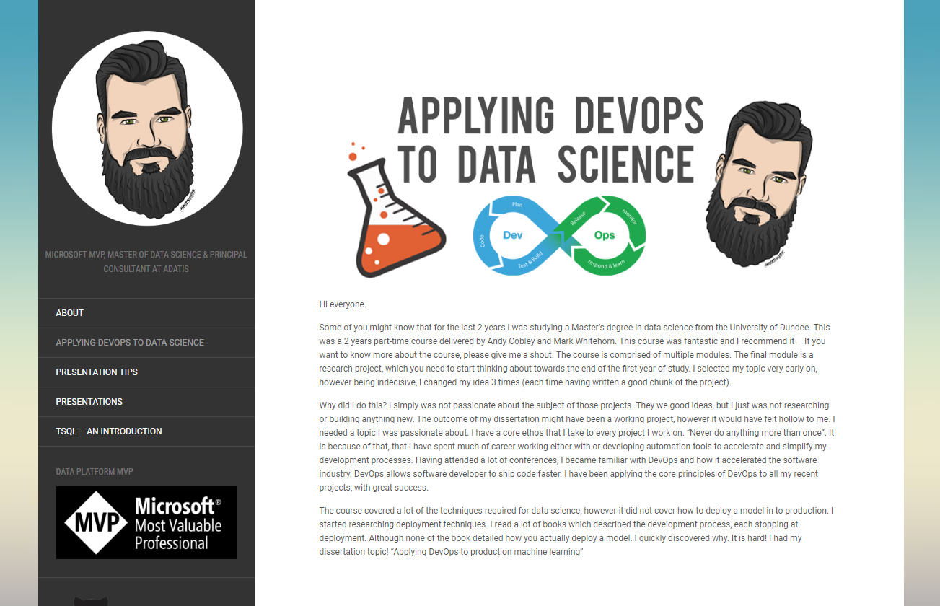
http://www.hyperbi.co.uk/applying-devops-to-data-science/
Notes:
Meet a great bunch of people
You’re a point of authority
You get to shout at people
You get in for free (save a bit of money)
Free drinks

